Slide 1
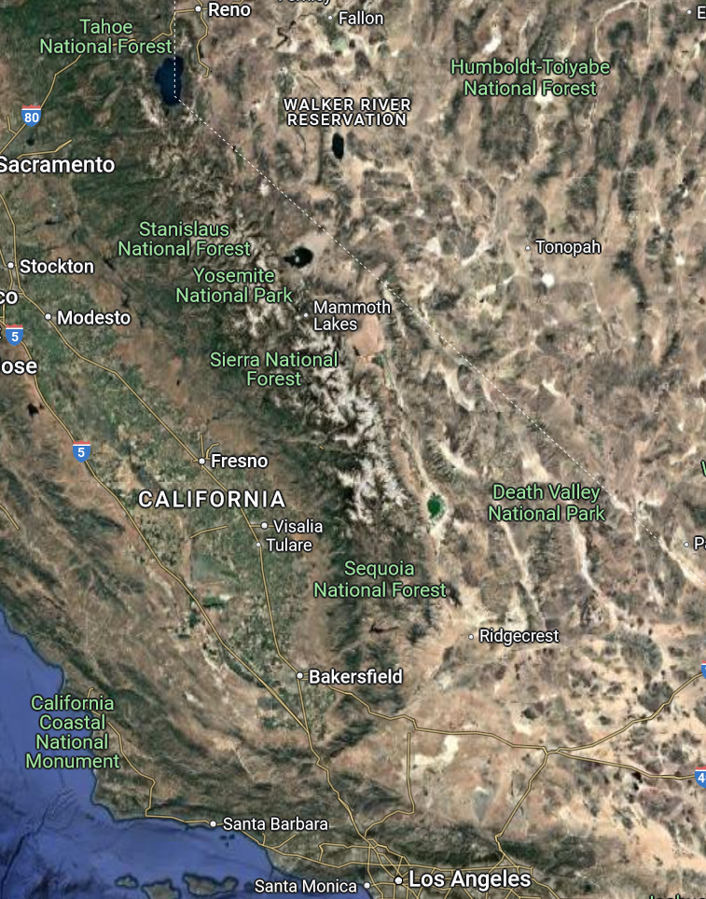
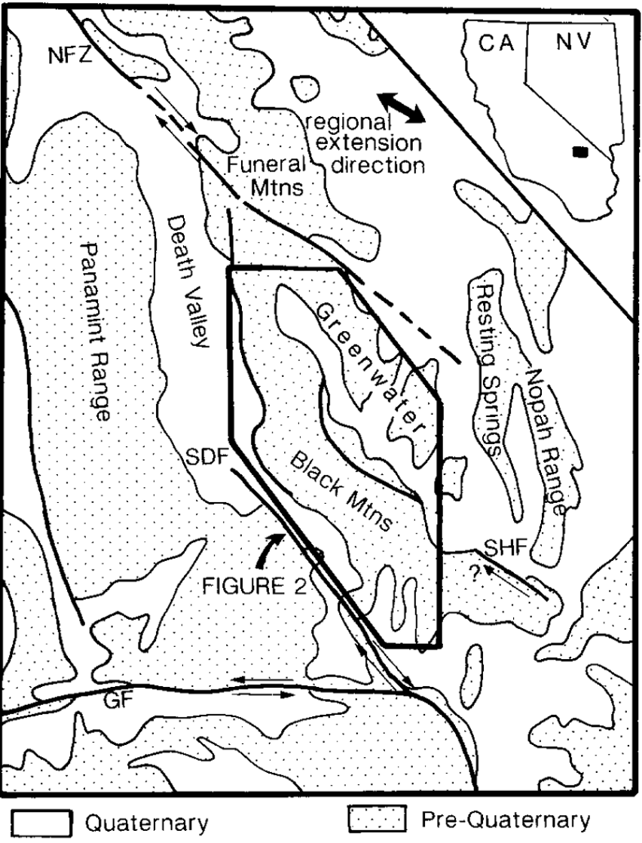
Interpretation and tectonic implications of cooling histories; an example from the Black Mountains, Death Valley extended terrane, California
Summary of paper by Daniel K. Holm & Roy K. Dokka (1993)
By Maggie Duncan
Death Valley Extended Terrain
Black Mountains
Lack miogeoclinal cover rocks of other ranges – where did they go?
Miogeoclinal: sedimentation forms a clastic wedge along the passive margin of continent
Authors use cooling histories to investigate Miocene unroofing history of Black Mountains
Important for understanding larger-scale lithospheric deformation and crustal kinematics

Slide 2
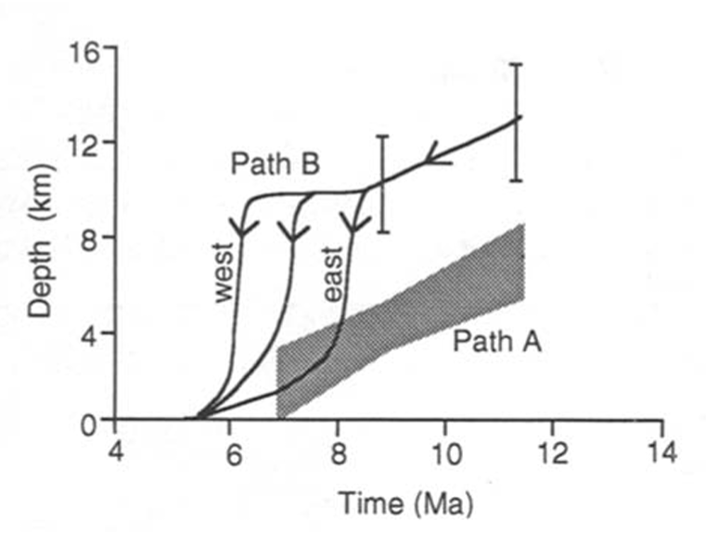
Two theories of Miocene unroofing
Pull-Apart Model (Wright et al., 1991) | Detachment Model (Holm & Wernicke, 1991; Holm, Snow & Lux, 1992)
Relatively constant, moderate unroofing rate | Initially slow-moderate unroofing rate with increase in rate over time
Initial depth of 11.6 Ma pluton ≤ 7 ± 1 km | Initial depth of pluton ~10-15 km
Erosional denudation with minor tectonism by high angle faulting beginning shortly after emplacement | Tectonic denudation by west-directed detachment faulting caused rapid, diachronous unroofing between ~8.5 and 6.0 Ma
Upper part of pluton exposed by ~7 Ma | Upper part of pluton exposed by 5 Ma
Pull-Apart model (Path A) dominated by erosion; Detachment model (Path B) dominated by tectonism.
Notes:
Two very different theories for unroofing, which affect entire tectonic history of the range: erosion ------------- tectonic denudation
Theories have significant differences in rate and amount of unroofing responsible for current exposure
- Pull-apart model: Neogene normal faulting (pull apart), volcanism, shallow intrusion controlled by right step across Sheephead & Furnace creek fault zones (NW striking strike-slip) → N-NE striking normal faults intervene and indicate crustal failure
- Inverted succession of Proterozoic-Paleozoic clasts in basin deposits – suggests at least partial erosional denudation
Detachment model: Black Mountains represent pre-extensional section of the crust unroofed along a west-dipping detachment zone
Amargosa chaos rocks = stranded hanging wall moved 15-20 km NW from initial position

Slide 3
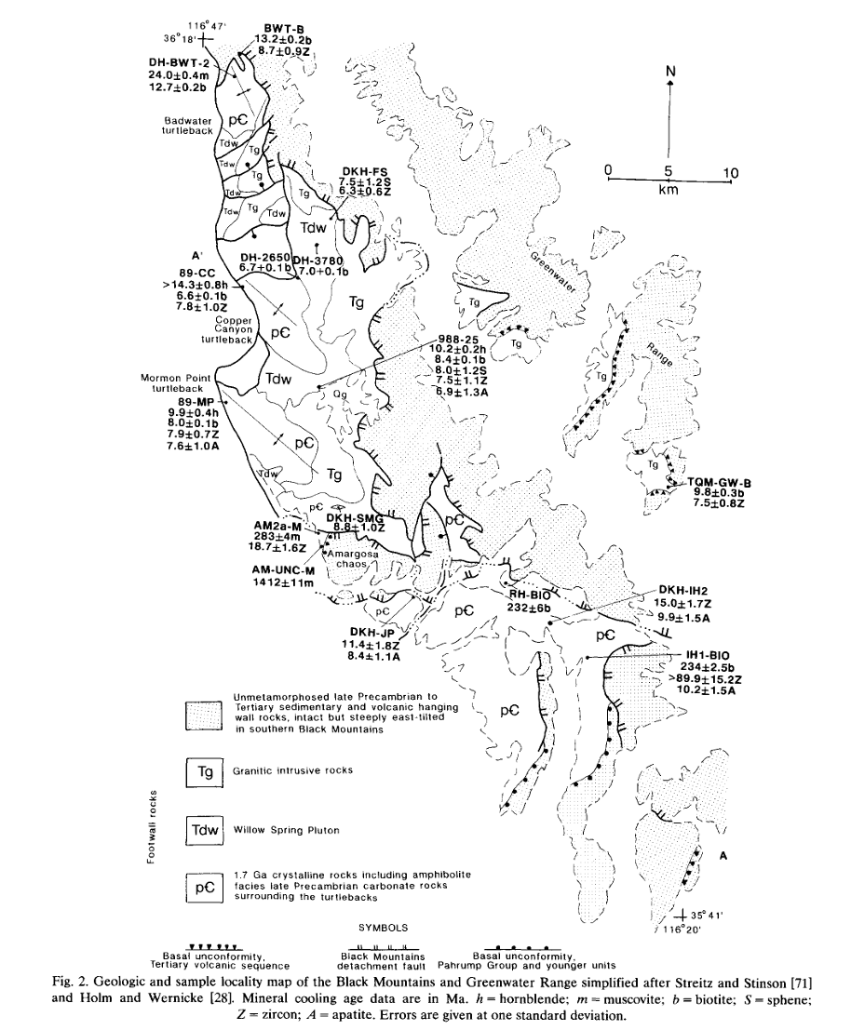
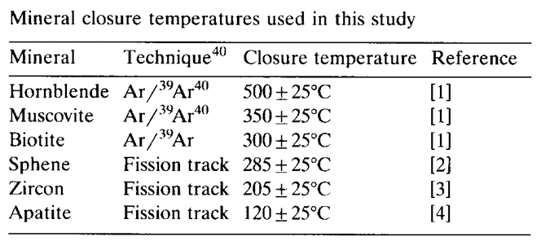
Methods
18 fission track ages collected from 11 samples across a ~45 km transect of range
Minerals: apatite, zircon, titanite
Combined with previously dated ⁴⁰Ar/³⁹Ar samples to construct cooling history
When ambient rock temp falls below annealing temperature, fission tracks preserved → used to determine cooling age of most recent cooling event in record
Each mineral constrains different portion of cooling path
Closure temps are cooling-rate dependent, i.e., higher closures temps are associated with rapid cooling.
Notes:
Fission of U235 induced via irradiation → tracks are created → induced tracks are counted
Spontaneous 238U tracks are also counted
since 235U/238U ratio is assumed constant in nature, 238U concentration can be calculated and an age can be determined
Fission track chronology: tracks in crystal lattice = trails of destruction from U238 spontaneous fission as the rock cools
As the rocks anneal at different temperatures (ie. cool to a point where the isotope composition is locked in), track lengths are proportional to the cooling rate
Rocks beneath “annealing zone” are at depth and track free (ie. age = 0)
Uplift begins cooling’ tracks begin to accumulate; fault motion can then be dated

Slide 4
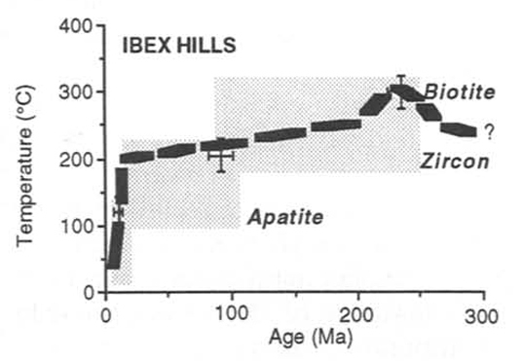
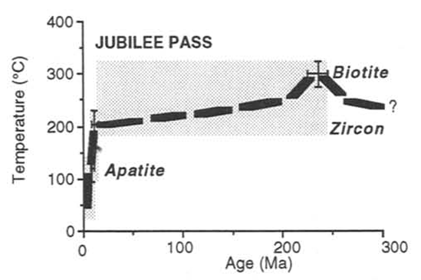
Southeastern Black Mountains
Cooling path envelopes suggest thermal resetting at 230-235 Ma
Similar ages in mountains to NW and SE
Evidence of tertiary extension
Preceded by intrusion at 230-235 Ma?
Major unroofing and tilting at ~13-8.5 Ma

Slide 5
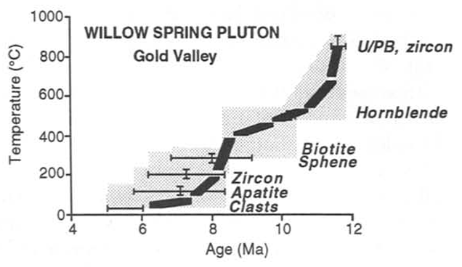
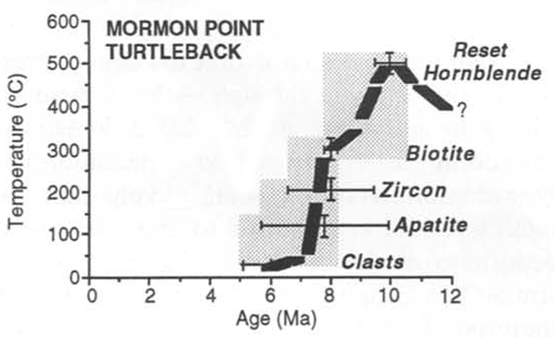
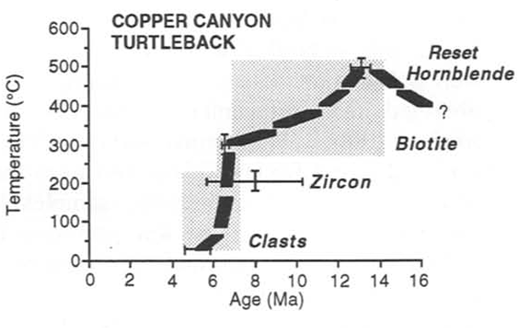
Central Black Mountains Core
Partial resetting by intrusion of Willow Spring Pluton ca. 11.6 Ma
Complete reset at 10 Ma (Turtlebacks)
Younger cooling ages and higher temperatures than SE, suggesting later unroofing
rapid cooling after 300°C
Unroofing ~8.5-6.0 Ma
(Precambrian basement)
(Precambrian basement)

Slide 6
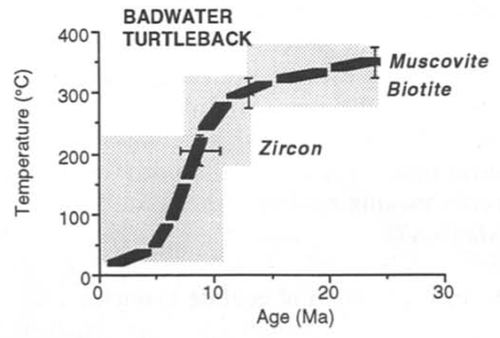
Northern Black Mountains
Rocks cooled slowly prior to onset of intrusion and unroofing at 11-12 Ma
Cooling rate increased after ~13 Ma
Unroofing and cooling slowed around 6-5 Ma

Slide 7
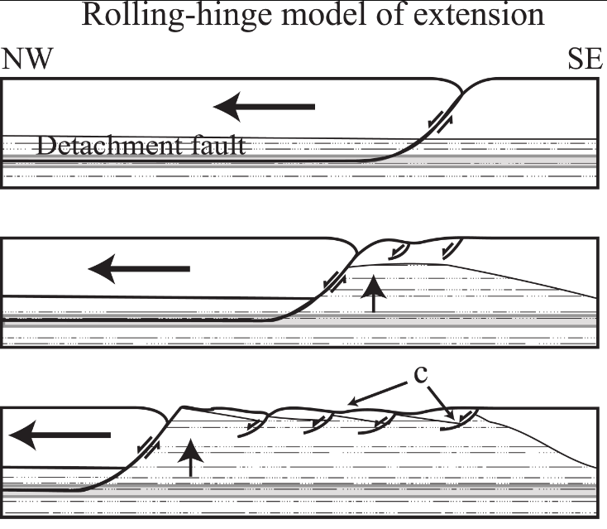
Conclusions
Migration of rapid cooling from SE – NW between 12-6 Ma
Tectonic denudation would likely cause more rapid cooling than erosional unroofing processes
Evidence in Black Mountains for tectonic denudation:
Rapid cooling rate, diachroneity of cooling
Cooling from progressively warmer temperatures toward NW
Mineral cooling ages decrease to NW
Supports “Rolling-hinge model” of unroofing
Sequential detachment of blocks (tilting) away from westward-migrating crustal block
Lower plate experienced flexural deformation as it pulled away from rigid, scoop-shaped hanging wall block
(see Sizemore et al., 2019 for more info)
In rolling-hinge model, exhumed footwall rocks are attenuated by shallow normal faults (c); most of extension is accommodated along the detachment fault (Sizemore et al., 2019).

